Slide 1
UC Berkeley Extension COMPSCI X433.6 ‘Introduction to Machine Learning with Python’ Final Project
Leland Burrill
Spring 2025
Notes:
Live Zoom, 3hrs, 10 Wednesday nights, $995.
$995/30 = $33.17/hr of instruction, plus lots of code.

Slide 2
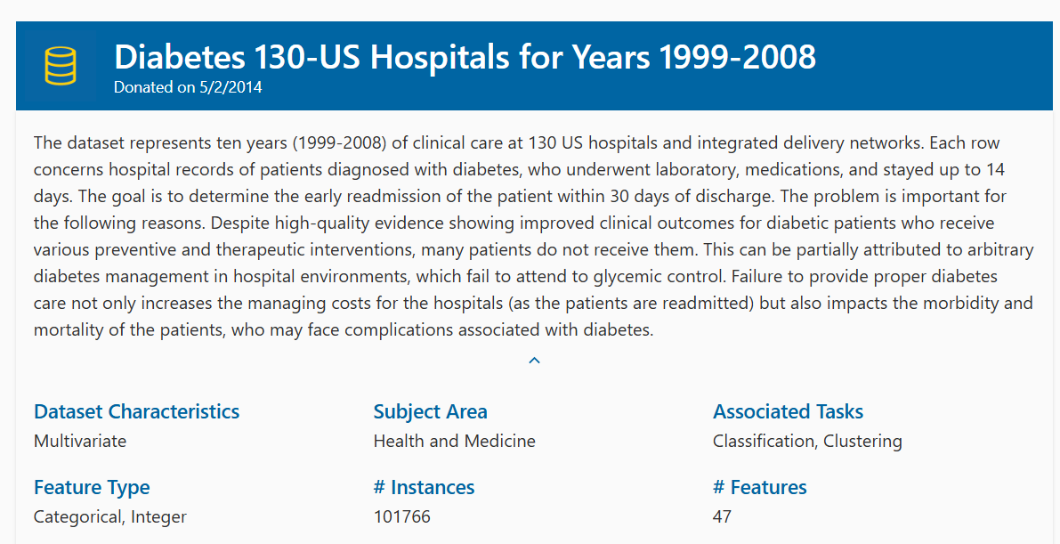
https://archive.ics.uci.edu/dataset/296/diabetes+130-us+hospitals+for+years+1999-2008
Notes:
Beata Strack, Jonathan P. DeShazo, Chris Gennings, Juan L. Olmo, Sebastian Ventura, Krzysztof J. Cios, and John N. Clore, “Impact of HbA1c Measurement on Hospital Readmission Rates: Analysis of 70,000 Clinical Database Patient Records,” BioMed Research International, vol. 2014, Article ID 781670, 11 pages, 2014.

Slide 3
Person-event data
Encounter-grain (101,766 unique encounters)
Each ‘encounter’ summarizes the event of an inpatient hospital stay
Patient identifier (71,518 unique person identifiers)
Persons linked across events by a ‘patient_nbr’
54,745 patient identifiers only 1 record in the data set
10,434 patient identifiers each have 2 records in the data set
…
1 patient identifier has 40 records in the data set
3-level target: diabetes[‘readmitted’]
Readmission in <30 days
>30 days
Not readmitted
Notes:
71,518-54,745 = 16,673 members with more than 1 record

Slide 4
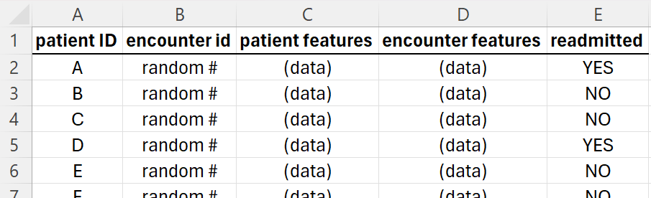
Data structure
49 features describing inpatient event
What
happened
next

Slide 5
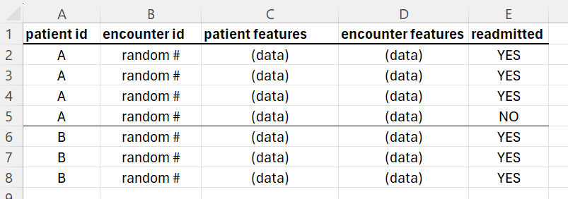
Absent data notion: Time ordering
For patients with more than 1 encounter, there is no information about which encounter occurred before any other.
Notes:
Example of a patient having 4 encounters: If one record has readmitted=‘NO’, then presumably that one occurred last in time. But we don’t know the time-ordering of the three other encounters.
Example of a patient having 3 encounters: When none of the patient records have readmitted=‘NO’, then we know nothing.

Slide 6
Person features (7)
Demographic Features (3)
Age
categorical data (binned by decade)
Gender
Race
five categories
Medical History (4)
Weight
missing on 98,569/101,766 records (96.86%)
Counts of admits, ER visits, et cetera, one year previous

Slide 7
Event features (40)
Admission and discharge codes (3)
Diagnosis codes (4)
Medical plan type, admitting physician specialty (2)
Length of stay, counts of events (4)
Lab tests, procedures, et cetera
Lab test results (2)
Binned categorically, with basic granularity, e.g., high-medium-low
Medication names and changes (25)
4-levels: steady dosage, increased, decreased, not given
Notes:
3+4+2+4+2+25= 40 + 7 demo and history + 1 target + 2 identifiers = 50

Slide 8
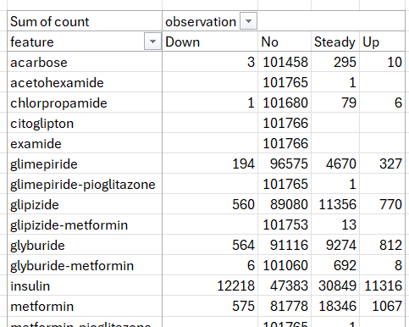
Exploratory work: 25 Rx features
Notes:
Every patient record includes 25 pharmaceutical features, as 4-level factor variables. Many of them are uninformative or weakly informative.

Slide 9
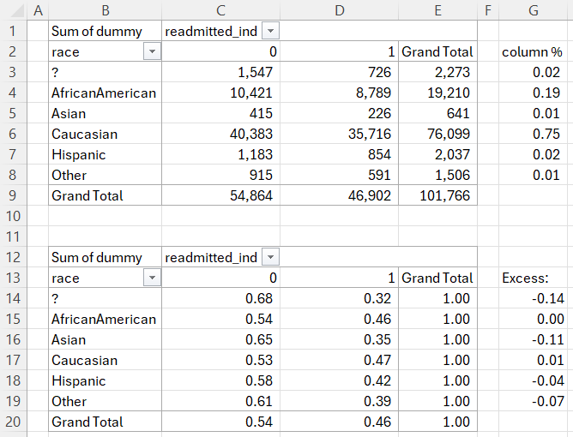
Exploratory work: conditional probabilities
P(A | B) = P(AB)/P(B), compare to P(A)
Notes:
P(A|B) = P(AB)/P(B)
P( readmitted=1 | race=‘?’ ) = ( 726/ 101,766 ) / ( 2,273/ 101,766) = 726 / 2,273 = 0.32, vs P(readmitted=1) unconditional = 46,902 / 101,766 = 0.46
75 readmitted ‘Asian’ would change the excess from -11% to -4%.
The ‘Asian’ category sees a large conditional impact on Readmitted, and 11% reduction in probability.
But the ‘Asian’ category is also the smallest category in ‘Race’, by far.
Keeping ‘Race’ in the model could make it hard for the model to generalize.

Slide 10
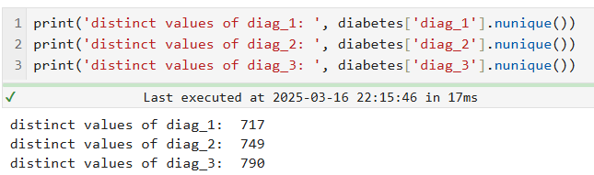
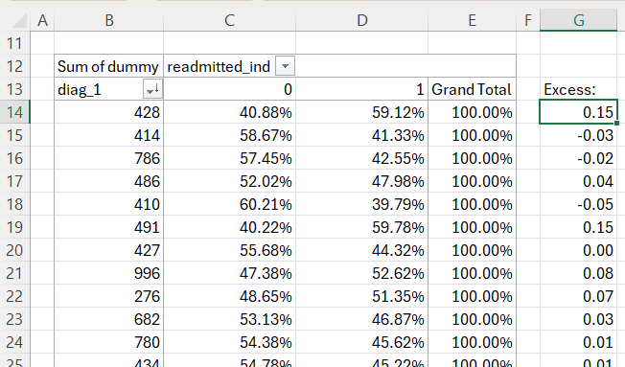
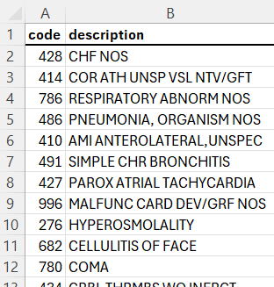
Exploratory work: diagnosis codes
Notes:
717+749+790 = 2,256 features– too many features after OneHotEncoder() treatment converts categorical data to 1/0-indicators.

Slide 11
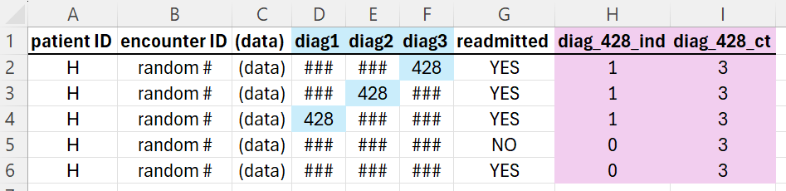
Example of derived features

Slide 12
Final feature summary
Started with 47 features
After excluding the target, patient, encounter labels
After dropping weakly or uninformative features and adding custom ones, there were 171 features, a mix of numeric and categorical
After OneHotEncoder() transforms categorical features, a final set of 231 features is used for modeling
RECORDS TRIMMED from model training:
Patients expiring, or discharged to hospice (not expected to readmit)
Patients under 20 years old, or over 80
Patients with more than 13 admits in the 10-year period of data collection
101,766 - 23,023 = 78,743 (final N)

Slide 13
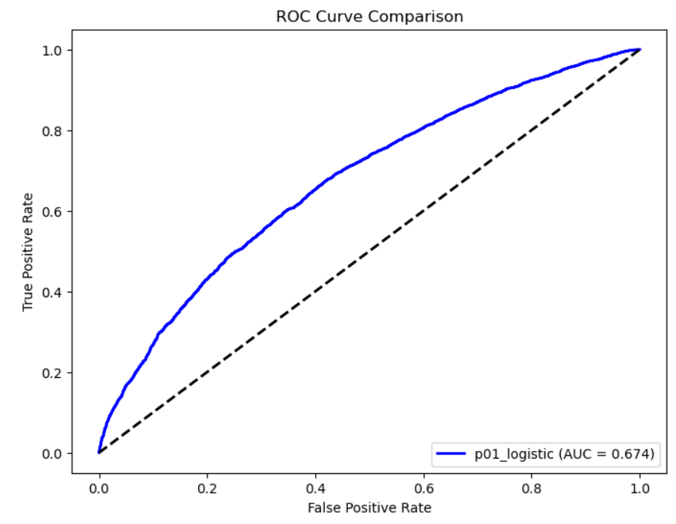
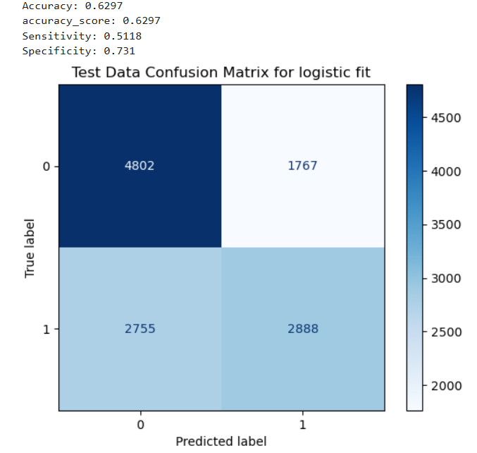
Basic logistic model fit on the native dataset (47 features, including dx codes)

Slide 14
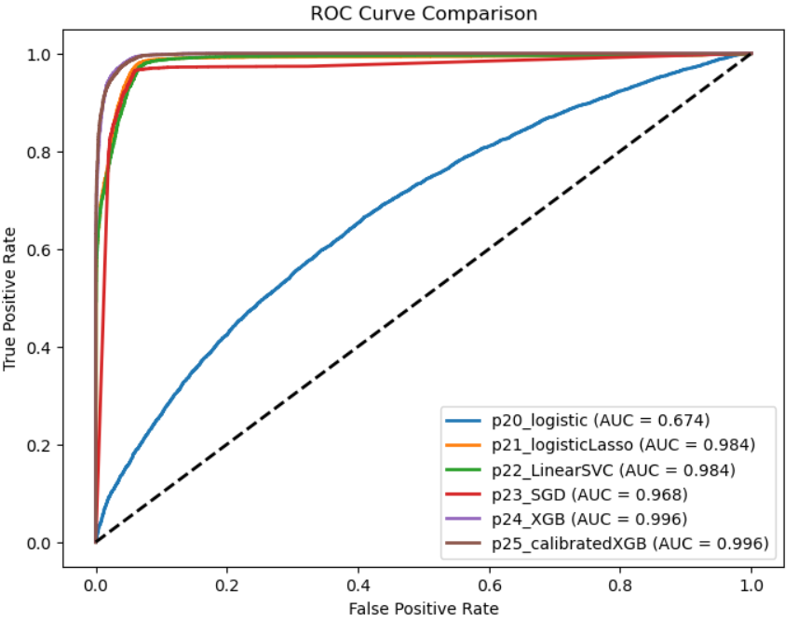
Model selection (on developed data set): XGBoost

Slide 15
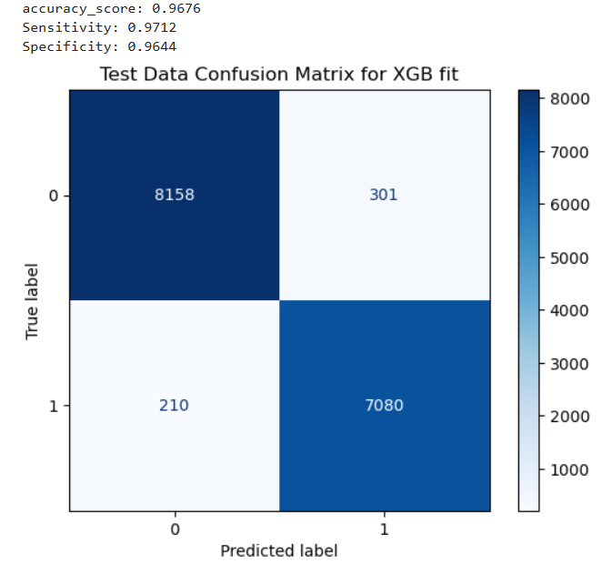

XGBoost, and Calibrated version
Notes:
Accuracy (XGB) = (8,158+7,080)/ (8,158+7,080+301+210) = 0.9676
Accuracy (XGB-Calibrated) = (8,244+6,970) / 8,244+6,970+305+230) = 0.966
Calibrated has 305-301=4 fewer false positives
Calibrated has 230-210=20 more false negatives
XGBOOST=
False positive rate= FP / (FP+TN) = 301/(301+8,158) = 301/8,459 = 0.0356
False negative rate= FN /(FN + TP) = 210/(210+7,080)=210/7290 = 0.0288
Calibrated XGBOOST=
False positive rate= FP / (FP+TN) = 305/(305+8,244) = 305/8,549 = 0.0357
False negative rate= FN /(FN + TP) = 230/(230+6,970)=230/ 7,200 = 0.0319
I would say a lower FNR is preferred for the readmission problem.

Slide 16
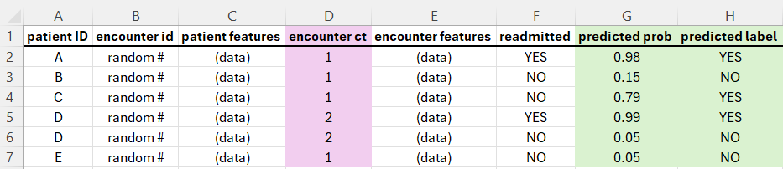
✅
✅
✅

Slide 17
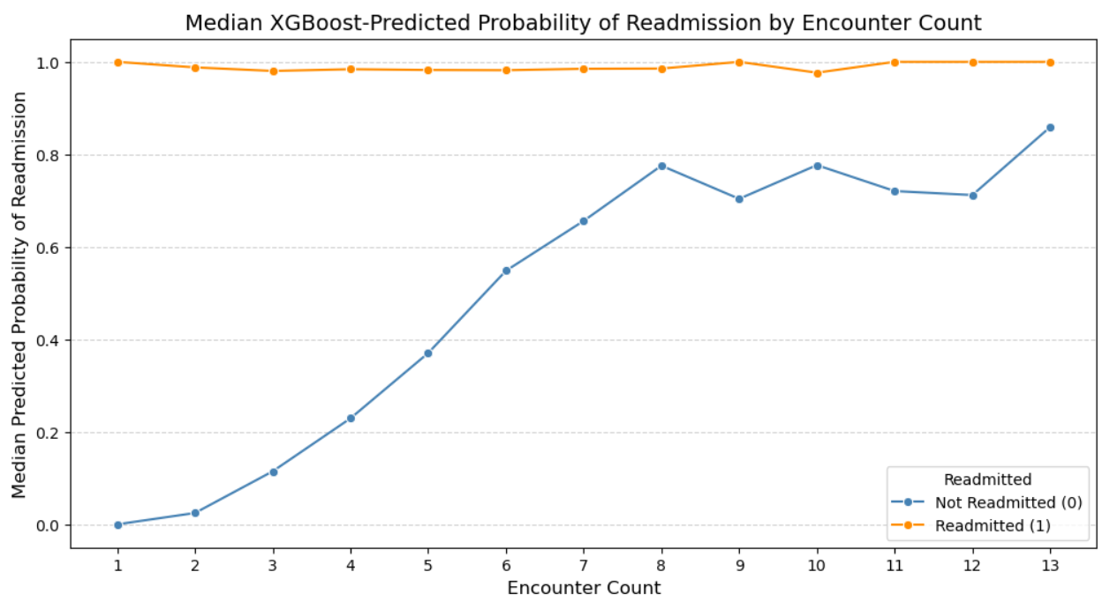

Slide 18
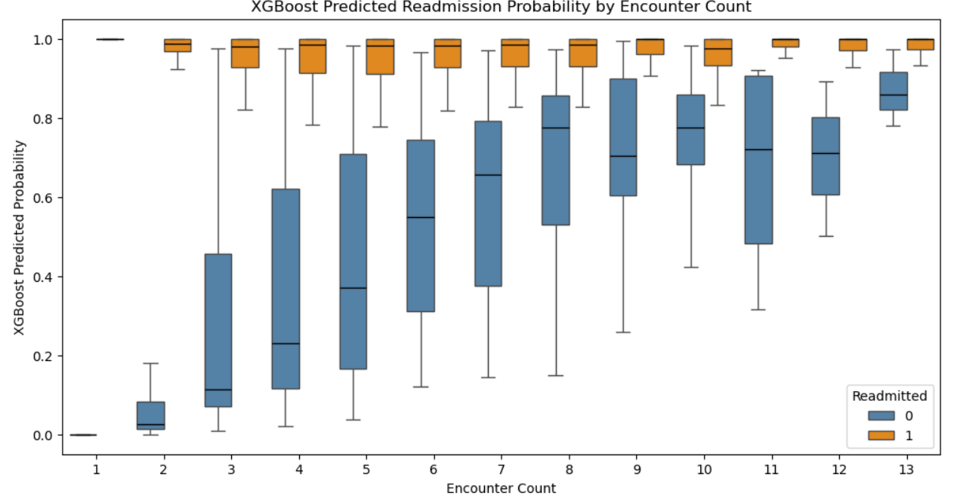

Slide 19
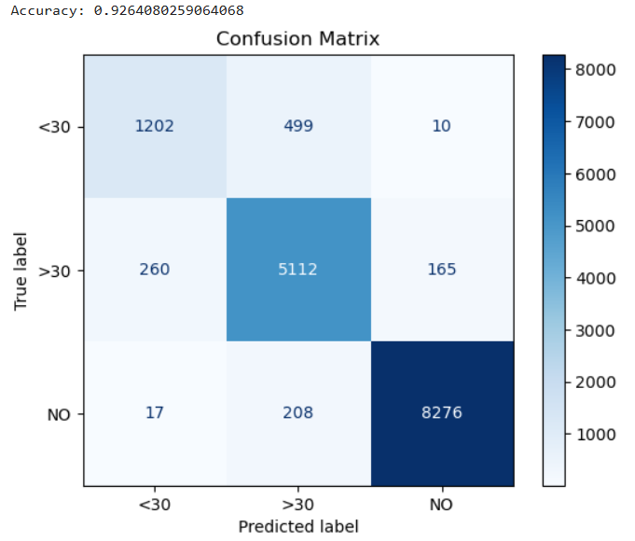
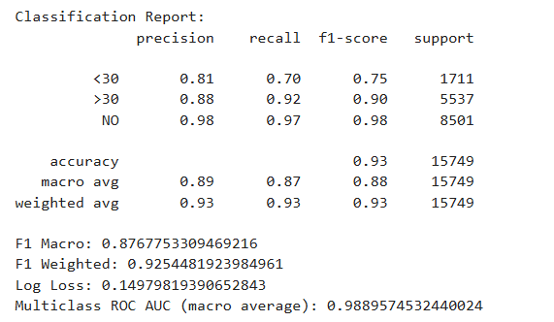
XGBoost, with three-level target XGBClassifier(objective='multi:softprob', **best_params, num_class=3, eval_metric='mlogloss’)

Slide 20
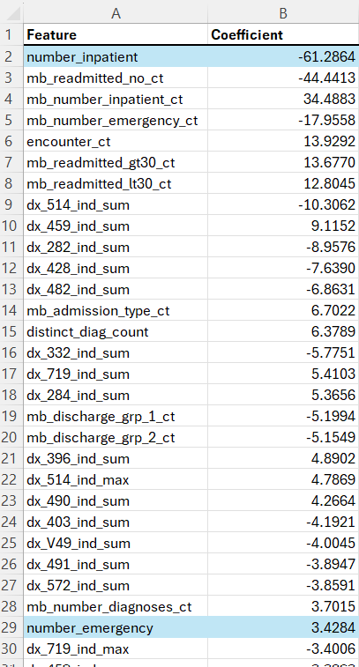

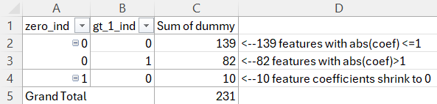
Large C from L1-penalized logistic fit indicates the model prefers less regularization Among 30 strongest features, 28 are engineered
Notes:
Data sets with many more observations that features respond less well to L1-regularization.
This data set has 231 features and 78,743 observations.

Slide 21
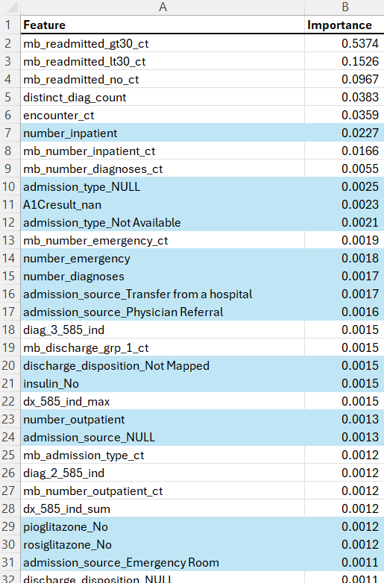
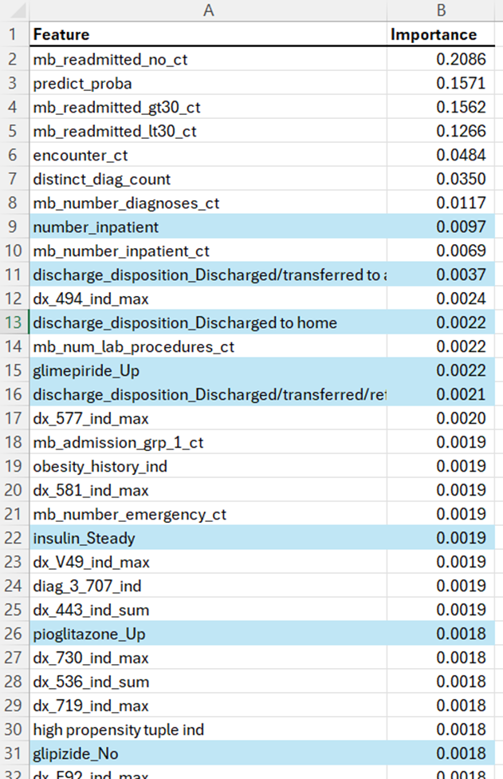
Feature importance for
XGBoost model fits
2-class target
Half of Top 30 most important features (in blue) come from original data set.
The rest were engineered.
3-class target→
8 of top 30 most important features come from the original data set.
22 were engineered

Slide 22
Punchlist
Refine 3-class target modeling
Try some neural nets
Approaches to feature selection using L2-penalties or PCA
Enhance DX-code features (e.g., propensity to not readmit, using 3-class target, et cetera)
Discuss/visualize relative merits of selecting FPR>FNR models

